Slide 1
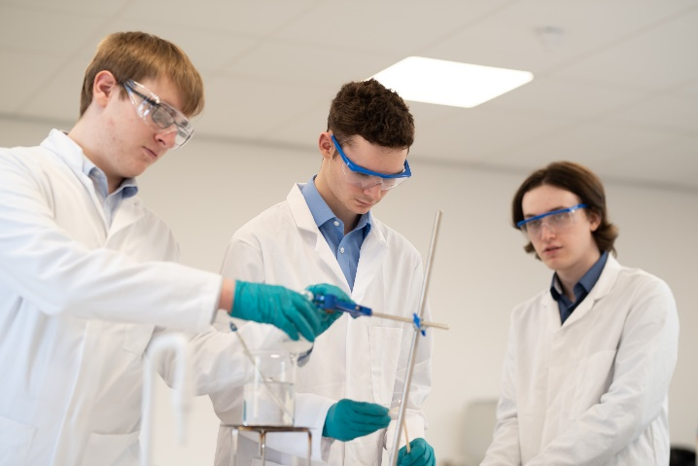
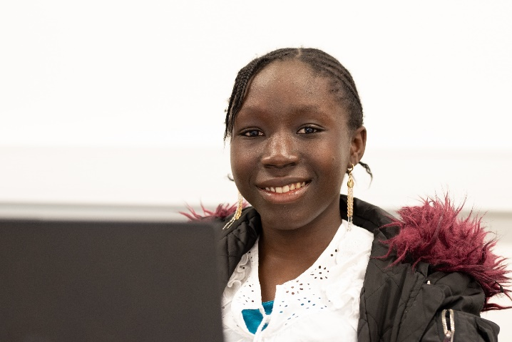
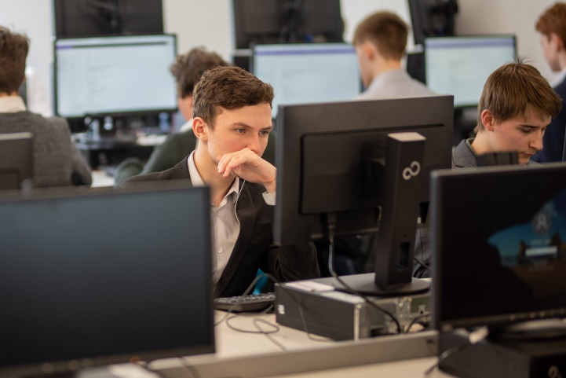
North East Futures UTC - 6th Form Opportunities
A Level and Pathway to Apprenticeship options available
Subjects include; Biology, Chemistry, Physics, Maths, Further Maths, English, Art, Psychology, Computer Science, Technical IT & Medical Science (see website for entry requirements)
Follow us on Eventbrite and Facebook for details on upcoming events
Applications now open for September 2023. Apply via our website www.nefuturesutc.co.uk/apply
Dress Down Fridays
Dedicated Social & Study Areas
Free onsite Gym

