Slide 1
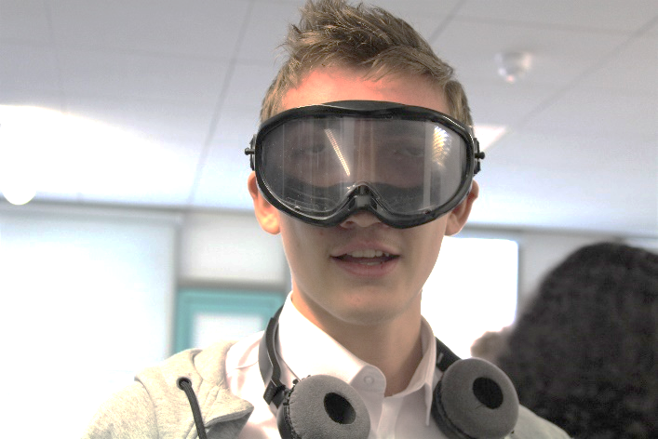
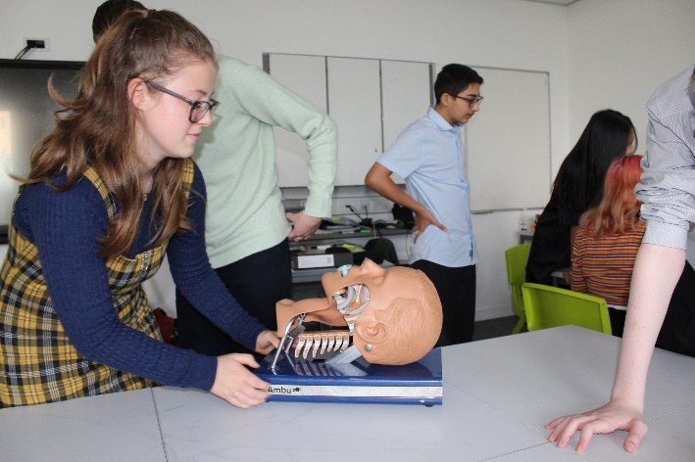
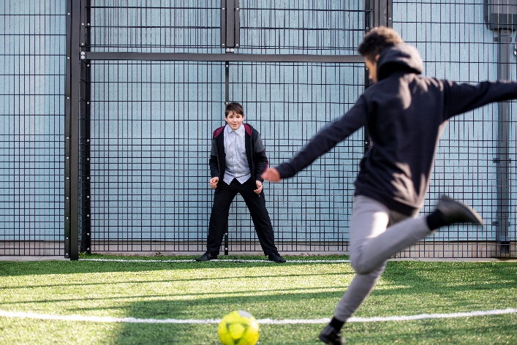
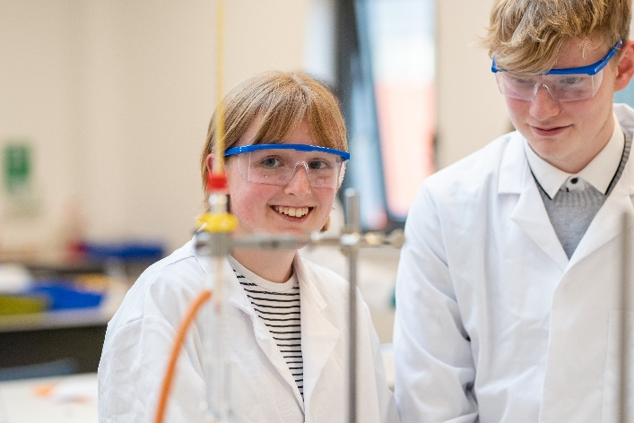
North East Futures UTC – GCSE Opportunities
Core GCSE Subjects taught to all – Maths, English, Biology, Chemistry, Physics, Computer Science.
Optional GCSE Subjects- Business, Art, Geography, History (Choose 1)
All students also get to experience specialist technical routes in Health Care Science & Digital Technology.
Next Open Evening - October 20st (see website or Facebook for info)
Applications now open for September 2023 & 2024. Apply via our website;
www.nefuturesutc.co.uk/apply

